Slide 1
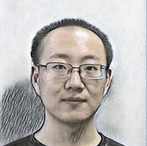
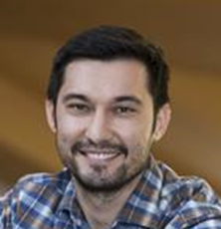
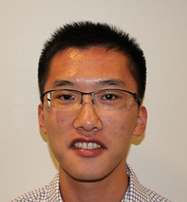



Plug-and-Play Priors for Reconstruction-based Placental Image Registration (PnP-RR)
Jiarui Xing, Ulugbek Kamilov, Wenjie Wu, Yong Wang, and Miaomiao Zhang
Notes:
Hello everyone, today I'd like to introduce our work Plug-and-play Priors for Reconstruction-based Placental Image Registration, and in short (PnP-RR)
This work is done by students and professors from both University of Virginia and Washington University in St. Louis.

Slide 2

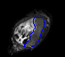
Monitoring Pregnancy Health through Diffusion-weighted MRI (DW-MRI)
DW-MRI
Notes:
Placental health is important
DW-MRI
Here’s a sample

Slide 3
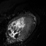
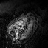


Motion Correction for DW-MRI
$$b=0$$
$$b=400$$
DW-MRI
…

Slide 4
Motion Correction for DW-MRI
$$b=0$$
$$b=400$$
DW-MRI
Motion Correction
…

Slide 5
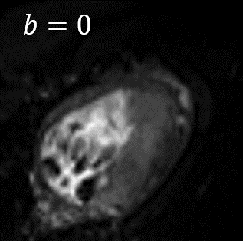
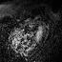
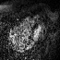


Motion Correction for DW-MRI
$$b=0$$
$$b=400$$
DW-MRI
$$b=700$$
$$b=900$$
Higher b-value -> stronger noise
Notes:
+ traditional method fail

Slide 6
Goal
Motion Correction for placental DW-MR images containing severe noise

Slide 7
Goal
Motion Correction for placental DW-MR images containing severe noise
Develop a noise-robust registration framework

Slide 8
Challenges
Traditional registration methods fail due to severe noises

Slide 9
Challenges
Traditional registration methods fail due to severe noises
Explicit objective function for optimization is unclear

Slide 10
Outline
Background: Image registration
Related Work
Proposed Method: Plug-and-play Reconstruction-registration (PnP-RR)
Experiments and results
Conclusion

Slide 11
Outline
Background: Image registration
Related Work
Proposed Method: Plug-and-play Reconstruction-registration (PnP-RR)
Experiments and results
Conclusion

Slide 12
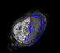

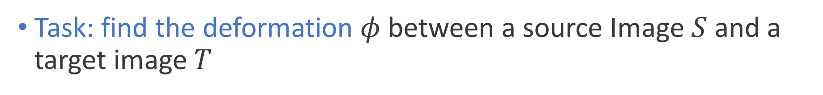
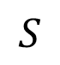
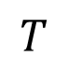
Background: Image registration
Task: find the deformation $φ$ between a source Image $S$ and a target image $T$
$$S$$
Registration
$$φ$$
$$T$$

Slide 13

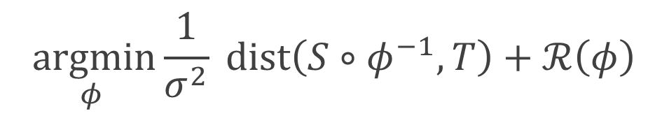
Background: Image registration
Task: find the deformation $φ$ between a source Image $S$ and a target image $T$
$$\underset{φ }{argmin}{\frac{1}{σ^{2}} dist\left(S∘φ^{−1}, T\right)+ℛ\left(φ\right)}$$
Noise variance
Image dissimilarity
Regularization for smooth transformation
$$S$$
Registration
$$φ$$
$$T$$

Slide 14
Outline
Background: Image registration
Related Work
Proposed Method: Plug-and-play Reconstruction-registration (PnP-RR)
Experiments and results
Discussion and conclusion

Slide 15
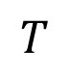

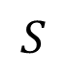
Related Work
Traditional Image Registration
$$S$$
Registration
$$φ$$
$$T$$

Slide 16
Related Work
Traditional Image Registration
Low b-value; clean
$$S$$
Registration
$$φ$$
High b-value; noisy
$$T$$

Slide 17
Related Work
Traditional Image Registration
Low b-value; clean
$$S$$
Registration
$$φ$$
→
FAIL for SEVERE NOISE-CORRUPTED images
High b-value; noisy
$$T$$

Slide 18
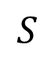
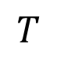

Related Work
Traditional Image Registration
$$S$$
Registration
$$φ$$
→
FAIL for SEVERE NOISE-CORRUPTED images
$$T$$
Idea: Denoising + Registration

Slide 19
Related Work
Traditional Image Registration
$$S$$
Registration
$$φ$$
→
FAIL for SEVERE NOISE-CORRUPTED images
$$T$$
Idea: Denoising + Registration
Question: “+”?

Slide 20
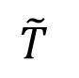
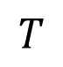

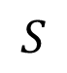
Related Work
Traditional Image Registration
$$S$$
Registration
$$φ$$
→
FAIL for SEVERE NOISE-CORRUPTED images
$$T$$
Two-step Method: denoising before registration
$$S$$
Registration
$$φ$$
denoising
$$T$$
$$\tilde{T}$$

Slide 21
Related Work
Traditional Image Registration
$$S$$
Registration
$$φ$$
→
FAIL for SEVERE NOISE-CORRUPTED images
$$T$$
Two-step Method: denoising before registration
$$S$$
Registration
$$φ$$
→
May NOT converge to OPTIMAL solution
denoising
$$T$$
$$\tilde{T}$$

Slide 22

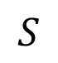
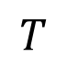
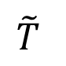
Related Work
Traditional Image Registration
$$S$$
Registration
$$φ$$
→
FAIL for SEVERE NOISE-CORRUPTED images
$$T$$
Two-step Method: denoising before registration
$$S$$
Registration
$$φ$$
→
May NOT converge to OPTIMAL solution
denoising
$$T$$
$$\tilde{T}$$
Joint Optimization Method
$$S$$
Joint registration-reconstruction
$$\tilde{T}$$
$$T$$
$$φ$$

Slide 23
Related Work
Traditional Image Registration
$$S$$
Registration
$$φ$$
→
FAIL for SEVERE NOISE-CORRUPTED images
$$T$$
Two-step Method: denoising before registration
$$S$$
Registration
$$φ$$
→
May NOT converge to OPTIMAL solution
denoising
$$T$$
$$\tilde{T}$$
Joint Optimization Method
$$S$$
Joint registration-reconstruction
$$\tilde{T}$$
→
Requires explicit objective function -> LIMITED CHOICES for denoisers
$$T$$
$$φ$$

Slide 24
Outline
Background: Image registration
Related Work
Proposed Method: Plug-and-play Reconstruction-registration (PnP-RR)
Experiments and results
Conclusion

Slide 25
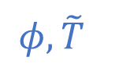


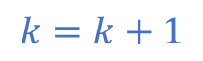
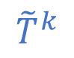
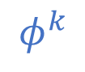

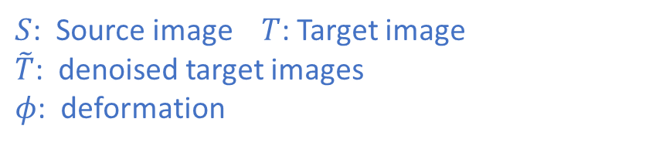
Proposed method: PnP-RR
$${register}_{σ}\left(S,\tilde{T}\right)$$
$$k=k+1$$
$$φ^{k}$$
$${\tilde{T}}^{k}$$
$${denoise}_{τ}\left(T\right|S,φ^{k})$$
$$⇒$$
convergence
$$φ,\tilde{T}$$
$S$: Source image $T$: Target image $\tilde{T}$: denoised target images
$φ$: deformation
Notes:
Trans: Math view, relate to and differ from joint optimization method

Slide 26
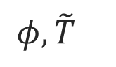


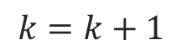
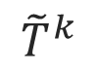
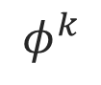
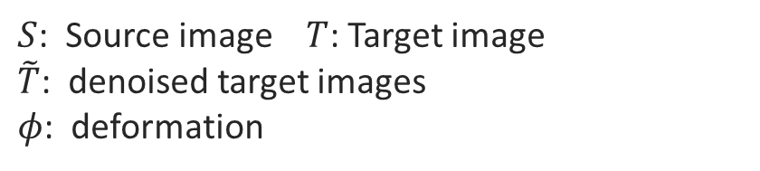
Proposed method: PnP-RR
$${register}_{σ}\left(S,\tilde{T}\right)$$
$$k=k+1$$
$$φ^{k}$$
$${\tilde{T}}^{k}$$
Plug-and-Play (PnP)
$${denoise}_{τ}\left(T\right|S,φ^{k})$$
$$⇒$$
convergence
$$φ,\tilde{T}$$
$S$: Source image $T$: Target image $\tilde{T}$: denoised target images
$φ$: deformation
Notes:
Trans: Math view, relate to and differ from joint optimization method

Slide 27



Proposed method: PnP-RR
$${register}_{σ}\left(S,\tilde{T}\right)$$
Advantages
TV
✔
TGV
✔
$$k=k+1$$
$$φ^{k}$$
BM3D
✔
$${\tilde{T}}^{k}$$
Neural Network
✔
Flexible to CHOOSE DENOISER
Better PERFORMANCE
Plug-and-Play (PnP)
$${denoise}_{τ}\left(T\right|S,φ^{k})$$
WORK
$$⇒$$
convergence
$$φ,\tilde{T}$$
$S$: Source image $T$: Target image $\tilde{T}$: denoised target images
$φ$: deformation
WORK
Simple to IMPLEMENT
Easy to TUNE
Notes:
Trans: Math view, relate to and differ from joint optimization method

Slide 28
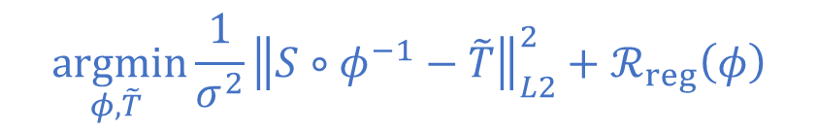
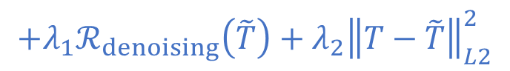
Proposed method: PnP-RR
Mathematical View
JOINT denoising-registration objective function
$$\underset{φ,\tilde{T} }{argmin}{\frac{1}{σ^{2}}{\left\|S∘φ^{−1}−\tilde{T}\right\|}_{L2}^{2}+ℛ_{reg}\left(φ\right)}$$
$$+λ_{1}ℛ_{denoising}\left(\tilde{T}\right)+λ_{2}{\left\|T−\tilde{T}\right\|}_{L2}^{2}$$
Notes:
Clearly explain what’s the difference with joint method, why it works

Slide 29
Proposed method: PnP-RR
Mathematical View
JOINT denoising-registration objective function
$$\underset{φ,\tilde{T} }{argmin}{\frac{1}{σ^{2}}{\left\|S∘φ^{−1}−\tilde{T}\right\|}_{L2}^{2}+ℛ_{reg}\left(φ\right)}$$
Registration
$$+λ_{1}ℛ_{denoising}\left(\tilde{T}\right)+λ_{2}{\left\|T−\tilde{T}\right\|}_{L2}^{2}$$
Denoising
Notes:
Clearly explain what’s the difference with joint method, why it works

Slide 30
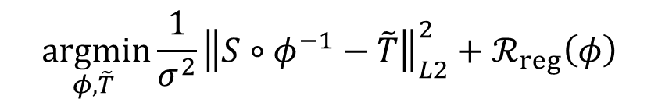
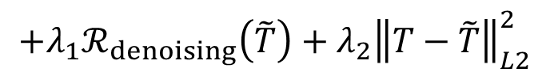
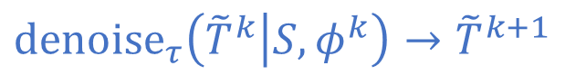
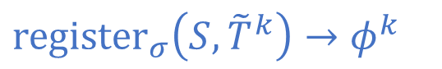
Proposed method: PnP-RR
Mathematical View
JOINT denoising-registration objective function
SPLIT Formulated as proximal algorithm
$$\underset{φ,\tilde{T} }{argmin}{\frac{1}{σ^{2}}{\left\|S∘φ^{−1}−\tilde{T}\right\|}_{L2}^{2}+ℛ_{reg}\left(φ\right)}$$
$${register}_{σ}\left(S, {\tilde{T}}^{k}\right)→φ^{k}$$
$$+λ_{1}ℛ_{denoising}\left(\tilde{T}\right)+λ_{2}{\left\|T−\tilde{T}\right\|}_{L2}^{2}$$
$${denoise}_{τ}\left({\tilde{T}}^{k} | S,φ^{k}\right)→{\tilde{T}}^{k+1}$$
Notes:
Clearly explain what’s the difference with joint method, why it works

Slide 31
Proposed method: PnP-RR
Mathematical View
JOINT denoising-registration objective function
SPLIT Formulated as proximal algorithm
$$\underset{φ,\tilde{T} }{argmin}{\frac{1}{σ^{2}}{\left\|S∘φ^{−1}−\tilde{T}\right\|}_{L2}^{2}+ℛ_{reg}\left(φ\right)}$$
$${register}_{σ}\left(S, {\tilde{T}}^{k}\right)→φ^{k}$$
Iteratively repeat until convergence
$$+λ_{1}ℛ_{denoising}\left(\tilde{T}\right)+λ_{2}{\left\|T−\tilde{T}\right\|}_{L2}^{2}$$
$${denoise}_{τ}\left({\tilde{T}}^{k} | S,φ^{k}\right)→{\tilde{T}}^{k+1}$$
Notes:
Clearly explain what’s the difference with joint method, why it works

Slide 32
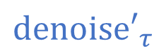
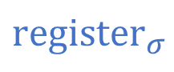
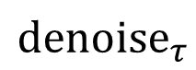
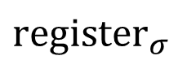
Proposed method: PnP-RR
Mathematical View
JOINT denoising-registration objective function
SPLIT Formulated as proximal algorithm
REPLACE Formulated as PnP algorithm
$$\underset{φ,\tilde{T} }{argmin}{\frac{1}{σ^{2}}{\left\|S∘φ^{−1}−\tilde{T}\right\|}_{L2}^{2}+ℛ_{reg}\left(φ\right)}$$
$${register}_{σ}$$
$${register}_{σ}$$
$$+λ_{1}ℛ_{denoising}\left(\tilde{T}\right)+λ_{2}{\left\|T−\tilde{T}\right\|}_{L2}^{2}$$
$${denoise}_{τ}$$
$${denoise′}_{τ}$$
Replace with arbitrary denoiser
Notes:
Clearly explain what’s the difference with joint method, why it works

Slide 33
Proposed method: PnP-RR
Mathematical View
JOINT denoising-registration objective function
SPLIT Formulated as proximal algorithm
REPLACE Formulated as PnP algorithm
$$\underset{φ,\tilde{T} }{argmin}{\frac{1}{σ^{2}}{\left\|S∘φ^{−1}−\tilde{T}\right\|}_{L2}^{2}+ℛ_{reg}\left(φ\right)}$$
$${register}_{σ}$$
$${register}_{σ}$$
Iteratively repeat until convergence
$$+λ_{1}ℛ_{denoising}\left(\tilde{T}\right)+λ_{2}{\left\|T−\tilde{T}\right\|}_{L2}^{2}$$
$${denoise}_{τ}$$
$${denoise′}_{τ}$$
Replace with arbitrary denoiser
Notes:
Clearly explain what’s the difference with joint method, why it works

Slide 34
Proposed method: PnP-RR
Mathematical View
JOINT denoising-registration objective function
SPLIT Formulated as proximal algorithm
REPLACE Formulated as PnP algorithm
$$\underset{φ,\tilde{T} }{argmin}{\frac{1}{σ^{2}}{\left\|S∘φ^{−1}−\tilde{T}\right\|}_{L2}^{2}+ℛ_{reg}\left(φ\right)}$$
$${register}_{σ}$$
$${register}_{σ}$$
$$+λ_{1}ℛ_{denoising}\left(\tilde{T}\right)+λ_{2}{\left\|T−\tilde{T}\right\|}_{L2}^{2}$$
$${denoise}_{τ}$$
$${denoise′}_{τ}$$
Specifying an image prior
Notes:
Clearly explain what’s the difference with joint method, why it works

Slide 35
Outline
Background: Image registration
Related Work
Proposed Method: Plug-and-play Reconstruction-registration (PnP-RR)
Experiments and results
Conclusion

Slide 36

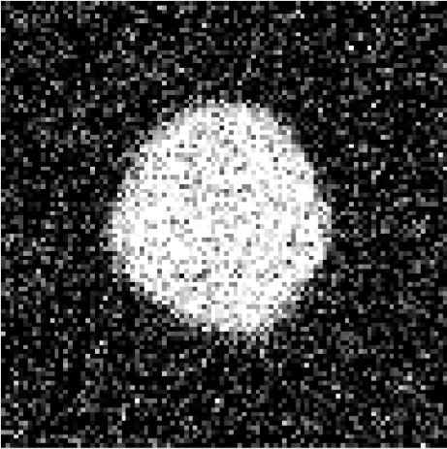
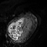
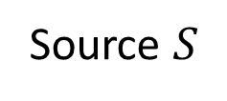
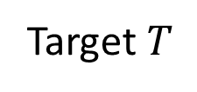
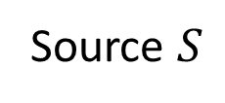
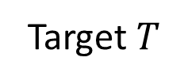
Experiments
Data
Algorithm Setting
2D synthetic images
Registration
Fourier-approximated Lie Algebras for Shooting (FLASH)^{[1]}
Denoising
Total variation (TV)^{[2]}
Total generalized variation (TGV)^{[3]}
Block-matching and 3D filtering (BM3D)^{[4]}
Source $S$
Target $T$
3D placental DW-MR images
Source $S$
[1] Zhang, et al., IPMI, 2017
[2] Rudin, Leonid I. et al., Physica D: nonlinear phenomena 60.1-4 (1992)
[3] Bredies et al., SIAM Journal on Imaging Sciences 3.3 (2010)
[4] Dabov et al. Image Processing: Algorithms and Systems, Neural Networks, and Machine Learning. Vol. 6064. (2006)
Target $T$

Slide 37




Results
2D synthetic images
$$σ=0.3$$
Source and Target
Source $S$
Target $T$
Result (deformed source)
Ours (TGV)
Ours (BM3D)
FLASH
Ours (TV)

Slide 38
Results
2D synthetic images: Dice Evaluation
Dice scores
⇒
parameters
⇒
two-step (TV)
ours (TV)
two-step (TGV)
ours (TGV)
two-step (BM3D)
ours (BM3D)

Slide 39
Results
2D synthetic images: Dice Evaluation
0.82
0.80
0.78
0.76
Dice
0.74
0.72
0.70
0.66
two-step (TV)
ours (TV)
two-step (TGV)
ours (TGV)
two-step (BM3D)
ours (BM3D)

Slide 40


Results
3D placental DW-MR images
128
128
128
128
50
50
Source $S$
Target $T$

Slide 41




Results
Propagated placental segments
Source
FLASH
Ours (TGV)
Target
Ours (TV)
Ours (BM3D)

Slide 42
Outline
Background: Image registration
Related Work
Proposed Method: Plug-and-play Reconstruction-registration (PnP-RR)
Experiments and results
Conclusion

Slide 43
Conclusion
Develop a robust registration framework, PnP-RR, that corrects motion for severely noise-corrupted images

Slide 44
Conclusion
Develop a robust registration framework, PnP-RR, that corrects motion for severely noise-corrupted images
Model has more flexibility to allow arbitrary denoising algorithm integrated with the registration task

Slide 45


Conclusion
Develop a robust registration framework, PnP-RR, that corrects motion for severely noise-corrupted images
Model has more flexibility to allow arbitrary denoising algorithm integrated with the registration task
Easy to implement and robust to parameter tuning
Paper
Slides

